Slide 1
CSE 331
Automata and computability
Equivalence of DFAs and NFAs
Summer 2026

Slide 2
Today's learning goals Sipser Ch 1.2, 1.3
Design NFA recognizing a given language
Convert an NFA (with or without spontaneous moves) to a DFA recognizing the same language
Decide whether or not a string is described by a given regular expression
Design a regular expression to describe a given language

Slide 3
Nondeterministic finite automata
"Guess" some stage of input at which switch modes
"Guess" one of finite list of criteria to meet
Input
M2
M1
Accept if
either (or both) accepts
M1
Input
M2

Slide 4
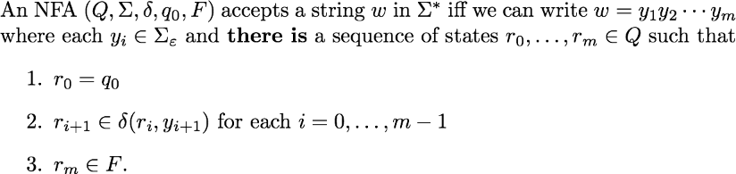
Acceptance in an NFA

Slide 5
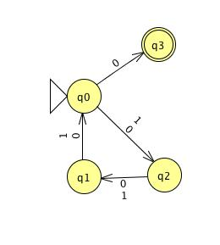
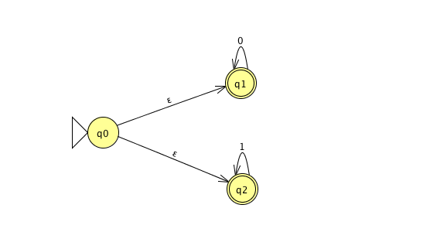
NFA

Slide 6
Simulating NFA with DFA
Not quite a closure proof, but …
Proof:
Given name variables for sets, machines assumed to exist.
WTS state goal and outline plan.
Construction using objects previously defined + new tools working towards goal. Give formal definition and explain.
Correctness prove that construction works.
Conclusion recap what you've proved.

Slide 7
Simulating NFA with DFA
For any language recognized by an NFA, there is a DFA
that recognizes this language.
Proof:
Given A, a language recognized by NFA N = (Q,Σ,δ,q0,F)
WTS there exists a DFA M with L(M) = A
Construction
Correctness
Conclusion

Slide 8
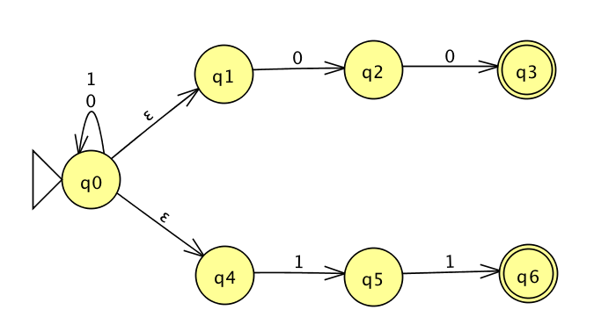
From NFA to DFA
Which of the following strings is accepted by this NFA?
The empty string
01
111
0
More than one of the above.

Slide 9
Subset construction
Given A, a language recognized by NFA N = (Q,Σ,δ,q0,F)
WTS there exists a DFA M with L(M) = A
Construction Define M = (Q', Σ, δ',q0', F') with
Q' = the power set of Q = { X | X is a subset of Q }
q0' = { states N can be in before first input symbol read }
F' = { }
δ' ( ) =

Slide 10
From NFA to DFA
Which states can this NFA be in before first input symbol is read?
q0
any state
q0, q1
q0, q4
q0, q1, q4

Slide 11
Subset construction
Given A, a language recognized by NFA N = (Q,Σ,δ,q0,F)
WTS there exists a DFA M with L(M) = A
Construction Define M = (Q', Σ, δ',q0', F') with
Q' = the power set of Q = { X | X is a subset of Q }
q0' = { q0 } U δ(q0, ε) U … = δ*(q0, ε)
F' = { }
δ' ( ) =

Slide 12
Subset construction
Given A, a language recognized by NFA N = (Q,Σ,δ,q0,F)
WTS there exists a DFA M with L(M) = A
Construction Define M = (Q', Σ, δ',q0', F') with
Q' = the power set of Q = { X | X is a subset of Q }
q0' = δ*(q0, ε)
F' = { }
δ' ( ) =

Slide 13
Subset construction
Given A, a language recognized by NFA N = (Q,Σ,δ,q0,F)
WTS there exists a DFA M with L(M) = A
Construction Define M = (Q', Σ, δ',q0', F') with
Q' = the power set of Q = { X | X is a subset of Q }
q0' = δ*(q0, ε)
F' = { guarantee at least one computation is successful }
δ' ( ) =

Slide 14
From NFA to DFA
What does it mean for a set of states X to guarantee at least one computation is successful?
X is a subset of F
X = F
X F is nonempty
X is an element of F
None of the above.
U

Slide 15
Subset construction
Given A, a language recognized by NFA N = (Q,Σ,δ,q0,F)
WTS there exists a DFA M with L(M) = A
Construction Define M = (Q', Σ, δ',q0', F') with
Q' = the power set of Q = { X | X is a subset of Q }
q0' = δ*(q0, ε)
F' = { X | X is a subset of Q and X F is nonempty }
δ' ( (X, x) ) = { }
U

Slide 16
Subset construction
Given A, a language recognized by NFA N = (Q,Σ,δ,q0,F)
WTS there exists a DFA M with L(M) = A
Construction Define M = (Q', Σ, δ',q0', F') with
Q' = the power set of Q = { X | X is a subset of Q }
q0' = δ*(q0, ε)
F' = { X | X is a subset of Q and X F is nonempty }
δ' ( (X, x) ) = { q in Q | q is in δ(r,x) for some r in X or accessible via spontaneous moves}
U
Types?

Slide 17
Subset construction examples

Slide 18
Subset construction examples

Slide 19
Subset construction examples

Slide 20
Recap
Regular sets of strings i.e., those that aren't too complicated are those that are
the language of some DFA, or equivalently,
the language of some NFA.
If a set of strings can be expressed as the result of complement, union, intersection, concatenation, Kleene star of regular languages, then it itself is regular.

